Slide 1
PIZZA STORE
WIPRO CAPSTONE PROJECT
GREAT LEARNING
NAME : Gumudavelli Rahul Kumar
EMAIL : rahulkumargumudavelli@gmail.com
PROJECT NAME : Pizza Store
WIPRO NGA –MERN-FY26
MERN Stack Full-Stack E-Commerce Application

Slide 2
DESCRIPTION
Pizza Store is a full-stack MERN e-commerce application designed for ordering pizzas online. Customers can register, browse menu items by category, add items to their cart, and place orders for delivery or pickup. The system also allows users to make payments, track their orders, and receive order notifications.
Administrators can manage menu categories and items, process customer orders, and monitor store operations. The application is built using Node.js and Express.js for the backend, MongoDB for the database, and React with Redux for the frontend. JWT authentication ensures secure access and proper user authorization within the system.
MongoDB
Express.js
React.js
Node.js
Redux
JWT Auth
REST API

Slide 3
TECHNOLOGIES USED
Frontend (Client – React)
React.js – Component-based UI library for building the complete user interface
Redux – Centralized state management for auth tokens, cart state, and order data
React Router – Client-side routing between Menu, Cart, Orders, Admin pages
Axios – HTTP client for making REST API calls to the Node.js backend
JWT Authentication – Token stored client-side to maintain secure sessions
Context API (Auth Context) – Manages logged-in user info and role (Admin / Customer)

Slide 4
TECHNOLOGIES USED
Backend (Server – Node.js / Express)
Node.js + Express.js – RESTful API server with 8 route modules (auth, menu, cart, orders, payments, messages, categories, addresses)
MongoDB + Mongoose – NoSQL database with 8 collections; seed data populated via seed.js
JWT (JSON Web Token) – Authentication & role-based access control (Admin vs Customer)
bcryptjs – Password hashing for secure credential storage and login verification
Stripe / Payment Module – Handles payment processing linked to orders collection
Middleware – CORS, auth guards, error handling across all protected API routes

Slide 5
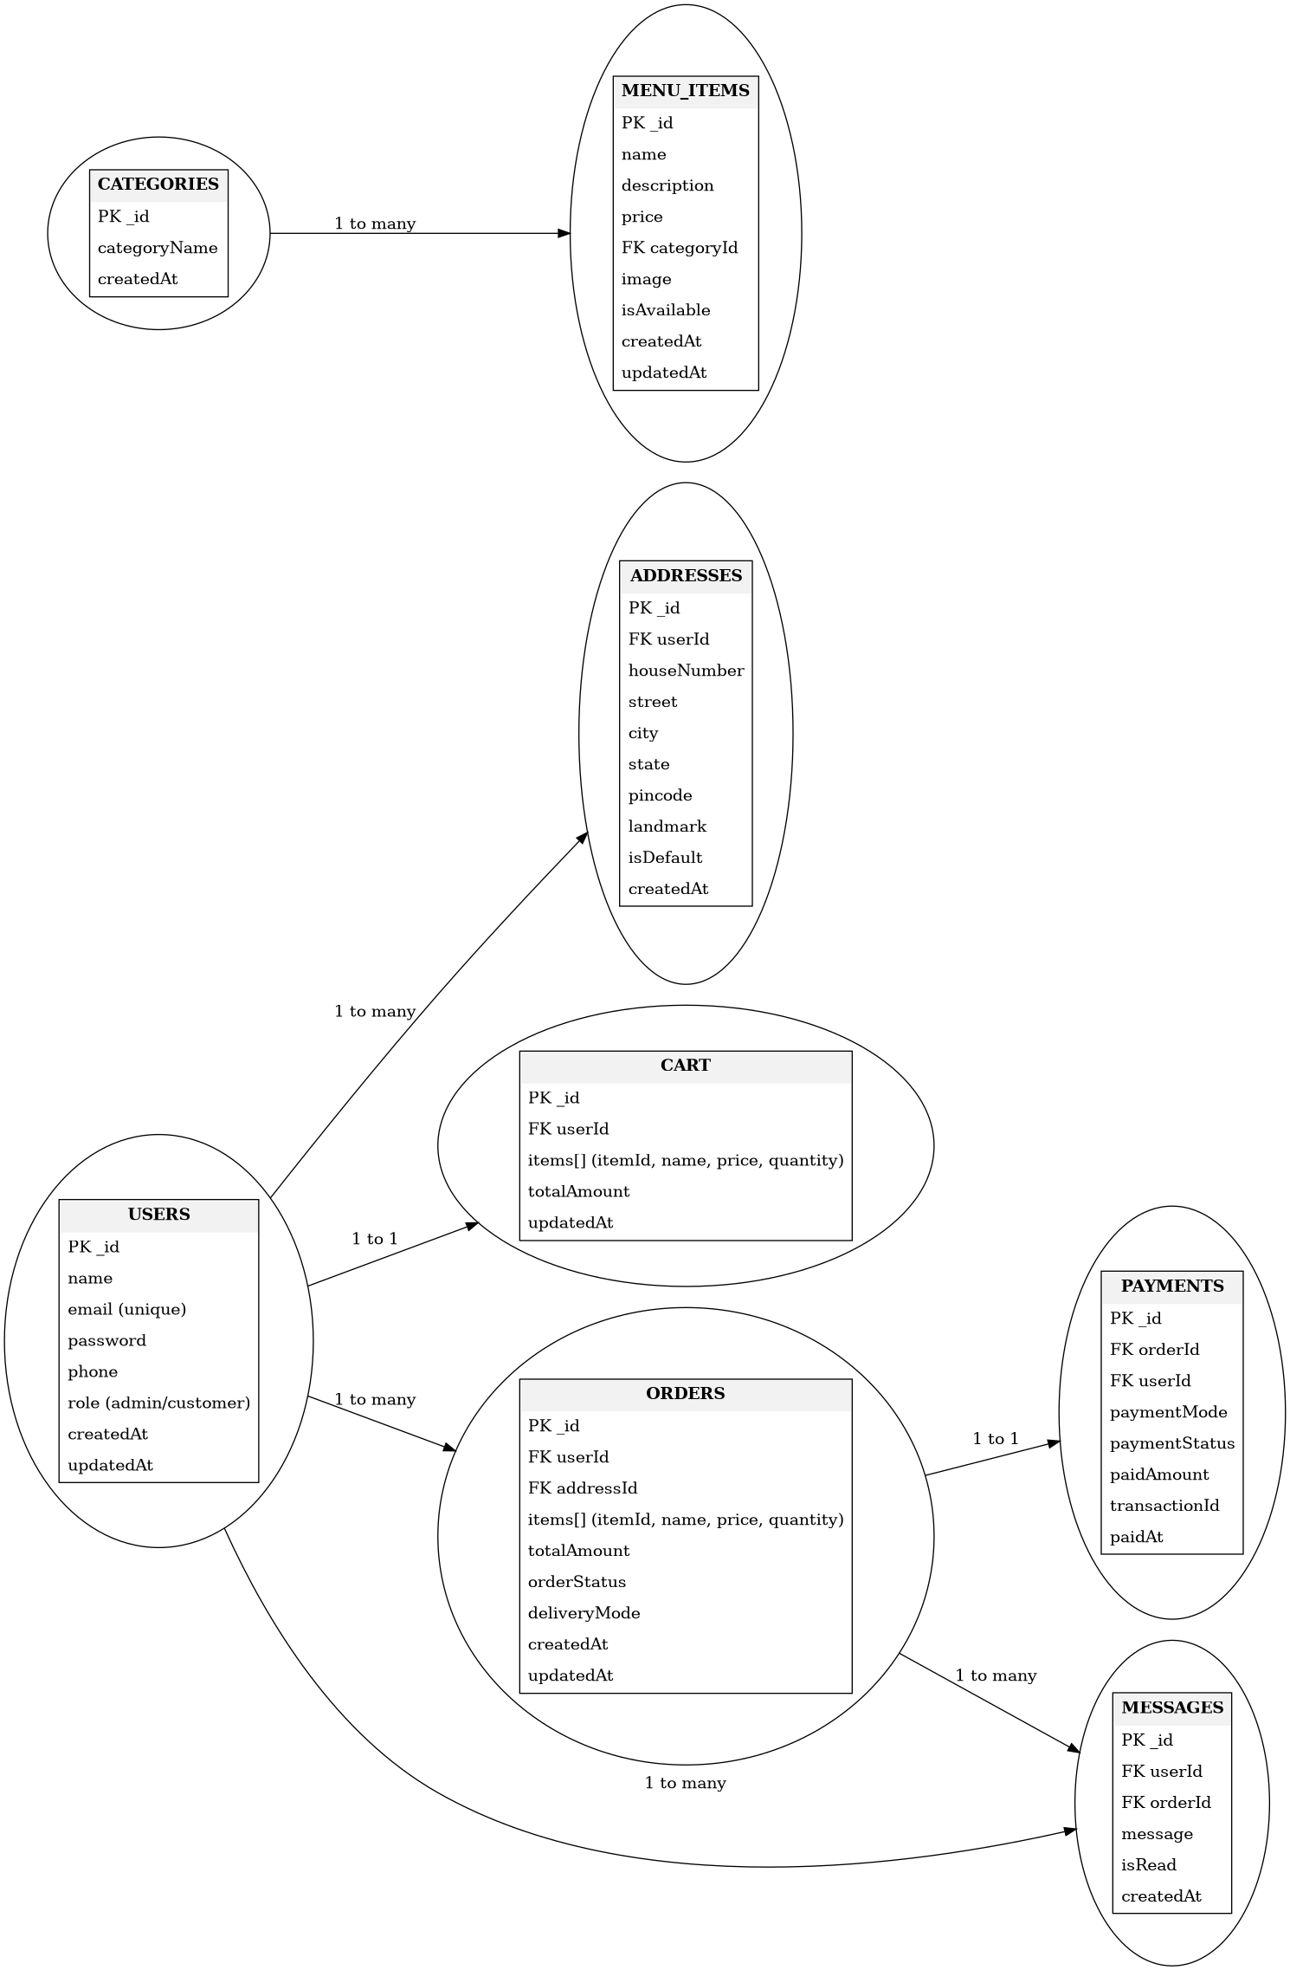
ER Diagram

Slide 6
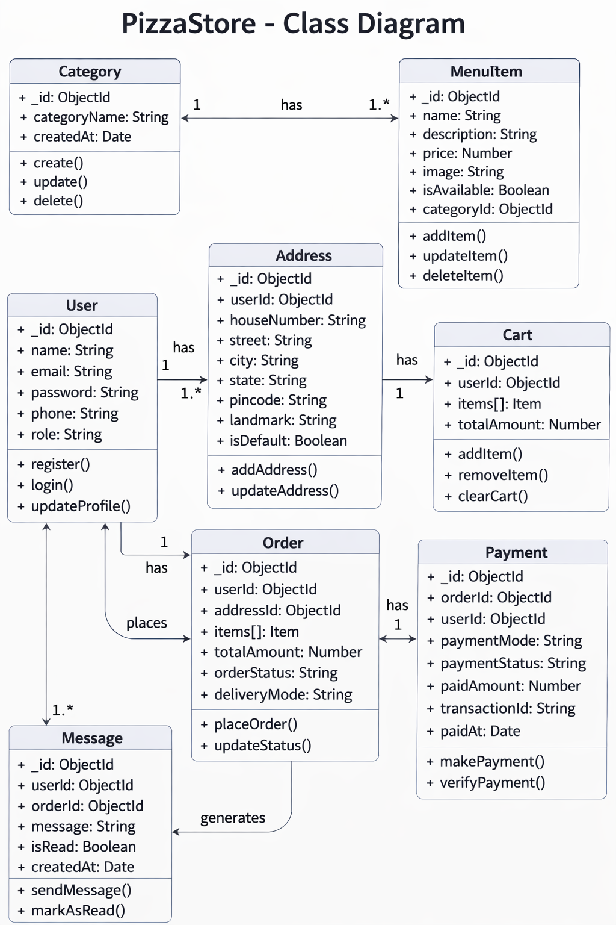
Class Diagram

Slide 7
API ENDPOINTS & DATABASE DESIGN
REST API Endpoints
MongoDB Collections (8)
POST /api/auth/register – Customer registration
POST /api/auth/login – Login + JWT token
GET /api/menu – Fetch all menu items
POST /api/cart – Add item to cart
POST /api/orders – Place new order
PUT /api/orders/:id – Accept / Reject order (Admin)
GET /api/payments – Revenue data (Admin)
GET /api/messages – Order alert messages
GET /api/cart – Fetch cart items
users
Auth & profile data
categories
Pizza categories
menuitems
Menu items + prices
addresses
Delivery addresses
carts
Active cart items
orders
Order records
payments
Payment history
messages
Order alert messages

Slide 8
THANK YOU
✉ rahulkumargumudavelli@gmail.com

